Slide 1
Performance Measures

Slide 2
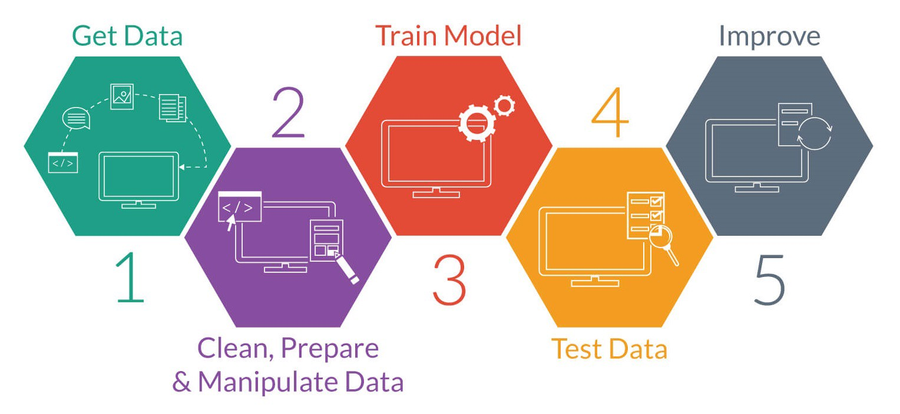
Steps involved in Machine Learning
This Photo by Unknown Author is licensed under CC BY-SA-NC

Slide 3
Confusion Matrix
Tabular summarization of the performance
 |  | Predicted Class
 |  | Positive | Negative
Actual Class | Positive | TP | FN
 | Negative | FP | TN

Slide 4
Confusion Matrix (contd…)
Cat vs Dog classification problem
Actual | C | C | D | C | D | D | C | D | C | D
Observed | D | C | C | C | D | C | D | D | C | D
 |  | Predicted Class
 |  | Positive | Negative
Actual Class | Positive
 | Negative

Slide 5
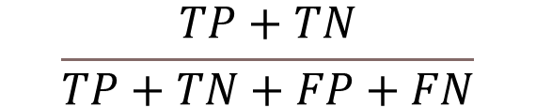

Performance Measures
Accuracy
Sensitivity or Recall

Slide 6
Performance measures (contd…)
Accuracy
Comment on the classifier, if accuracy is 80% ?
 |  | Predicted Class
 |  | Positive | Negative
Actual Class | Positive | TP | FN
 | Negative | FP | TN

Slide 7


Performance Measures
True Positive Fraction (Sensitivity)
False Positive Fraction
1-Specificity

Slide 8
Decision Model

Slide 9
Threshold

Slide 10
Threshold

Slide 11
Threshold

Slide 12
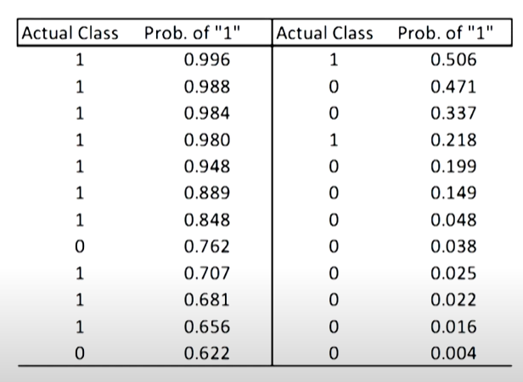
Output of Logistic regression
Unit-9, Lecture-41 & 42: https://nptel.ac.in/courses/106/107/106107220/

Slide 13
Performance measures (contd…)
 |  | Predicted Class
 |  | Positive | Negative
Actual Class | Positive | TP | FN Type-II error
 | Negative | FP Type-I error | TN

Slide 14
ROC: Receiver Operator Characteristics Curve

Slide 15
ROC
Effect of threshold on Sensitivity and Specificity

Slide 16
ROC

Slide 17
Good and Bad Classifiers

Slide 20
Analysis of Different points in ROC
Corner points
A(0,1): best
B(1,0): wrost
C(0,0): ultra-conservative i.e. every sample is -ve
D(1,1): Ultra-liberal i.e. every sample is +ve
Above diagonal
X(0.1, 0.6), Y(0.2,0.7), Z(0.2, 0.5)
Below diagonal
W(0.4,0.2)

Slide 21
Validation Measures for Clustering
External
use external information not present in the data
Internal
measures evaluate the goodness of a clustering structure without respect to external information

Slide 22
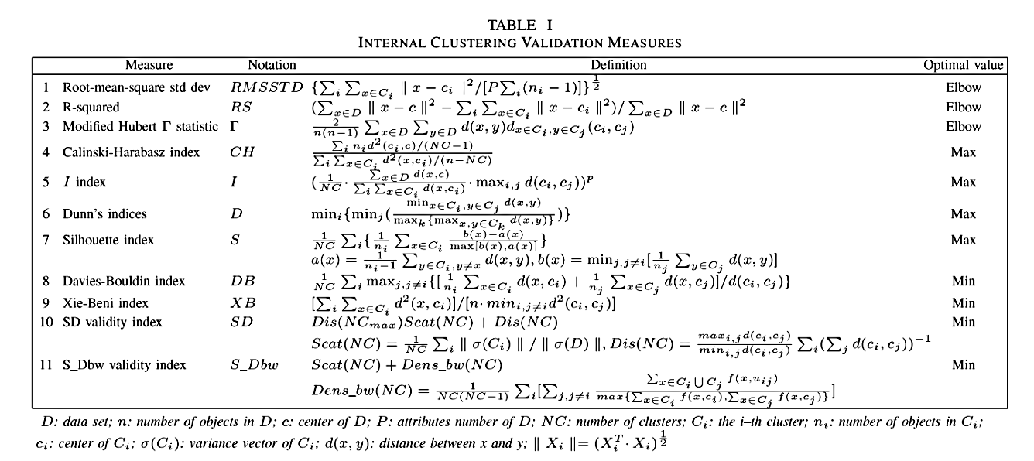
Validation Measures for Clustering

Slide 23
References
Ethem Alpaydin. 2010. Introduction to Machine Learning (2nd. ed.). The MIT Press.
Unit-9, Lecture-41 & 42: https://nptel.ac.in/courses/106/107/106107220/

